Slide 1
Activity Tracking
Jenzabar EX Student Life Module
Henrique Donati
2017

Slide 2

Vocabulary
Year
Session
Activity
Meeting
Participation
Attendance

Slide 3
Relations
Year
Session
Activity
Meetings
Participants
Attendants

Slide 4
Our Approach to Tracking
Jenzabar EX
Create Activities
Assign Activities to the Session
Create meetings
Ipod/Scanners
Gather Attendance information by scanning ID cards
Jenzabar JICS (myUIU)
Record Attendance
Infomaker/Excel
Reports

Slide 5
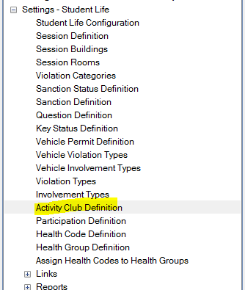
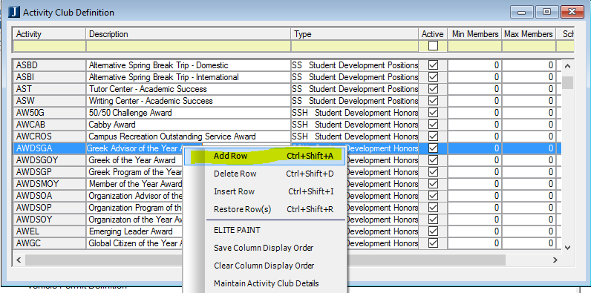
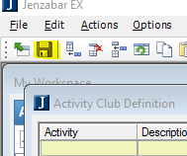
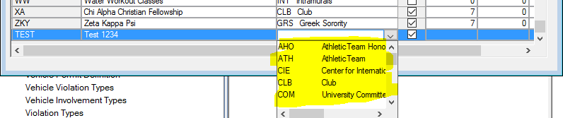
Create Activities
If you haven’t created any instance of an activity yet, you’ll need to open a window called “Activity Club Definition” in EX.
Right click anywhere in the window and add a row.
Fill out the information of the activity, including the respective Type.
Save and done.

Slide 6
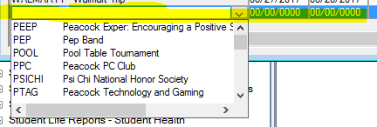
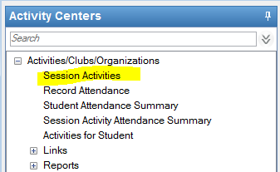
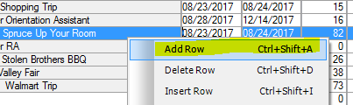
Assign Activities to the Session
Open the window “Session Activities”
Right click anywhere in the window and add a row.
Find your activity in the dropdown.
Add Begin and End Date to it.
Save and Done.

Slide 7
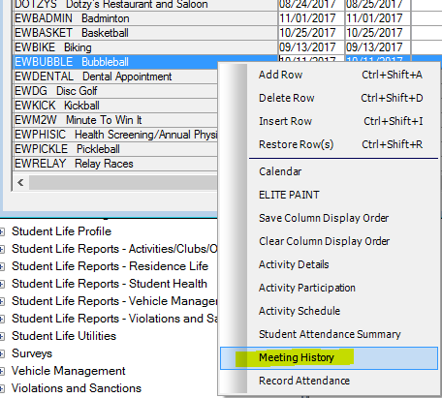
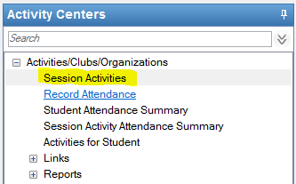
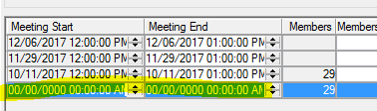

Create meetings
Still under the “Session Activities” Window
Right click on the desired activity and select “Meeting History”
If there is a meeting already set, right click on any and select ‘Add a Row”, otherwise move to next step
Enter meeting start and end dates (Please don’t use any Seconds)
Save and done

Slide 8
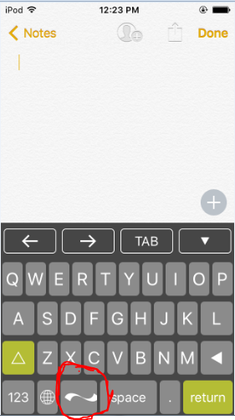

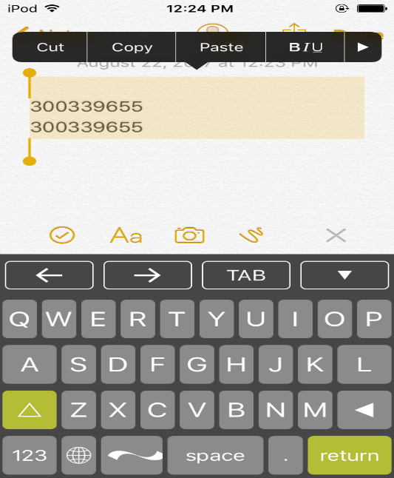
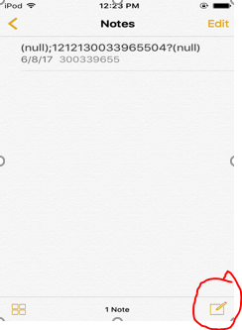

Scanning Cards
Open Notes on IPod
Click the button with the pen on the bottom right
Select the scanner keyboard and choose the scanner option
Scan IDs
Save and send notes

Slide 9
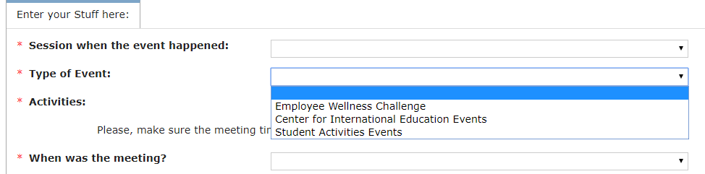
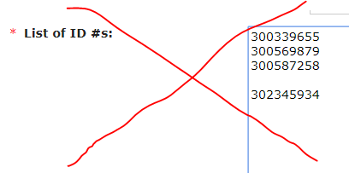

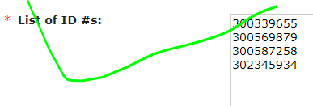

Record Attendance
Got to the form in my.uiu.edu
Select the respective information in order from top to bottom
Paste IDs and make sure there are no empty lines
Submit and done
Note: These ID numbers are fictitious

Slide 10
Reports
Main report is located under:
J:/Reports/Additional Reports/SA/UIU Staff/sa_reports_hd.pbl > r_student_activities_master_hd
Academic Year = 2017, 2018, 2019…
ACT_TYPE = SAE (Student Activities), CIE (Center for Intl Edu), EWC (Employee Wellness) and CDV (Career Dev.)
Feel free to request the analyst responsible for your area for a report and specify the information you’d like to see in it.
A few examples are:
Number of participations
Date of birth, age or country of citizenship
State or city of residency, emails, phone numbers
GPA, Major, Grade
Between many others

Slide 11
Questions??
Thank you!

